Slide 1
MBA532 – AI in Business
MODULE 8 – AI Ethics and Responsible AI

Slide 2
AI Ethics
AI Ethics

Slide 3
Definition of AI Ethics
According to IBM, AI Ethics is a set of moral principles which help us discern between right and wrong. AI ethics is a multidisciplinary field that studies how to optimize AI's beneficial impact while reducing risks and adverse outcomes.
Examples of AI ethics issues include data responsibility and privacy, fairness, explainability, robustness, transparency, environmental sustainability, inclusion, moral agency, value alignment, accountability, trust, and technology misuse.
Source: What is AI Ethics?

Slide 4
Increased Awareness of what AI Systems can Track
There is a need to educate the public to increase awareness about possible tracking is key to assure that individual’s make informed choices. This is because AI systems can track user engagement using several metrics (e.g., an individual’s online reading habits, preferences and likely state of knowledge), it is possible to increase a message’s persuasive impact on that individual.
More specifically, for any given online message (e.g., an ad), the AI system may track if an individual has read a given message, the time duration to read it, and if they followed-up to review additional links embedded within that message. Furthermore, AI systems can be designed to use this information to predict the success or failure of an attempt to influence the individual with that message. Over time, given the success record of machine learning applications, the reliability and accuracy of such predictions will increase. This approach is often used by online advertisers to copy-test different advertising messages before launching a national online ad campaign.

Slide 5
Increased awareness of Anthropomorphism
Increased awareness needed of the widespread human predisposition to anthropomorphize or develop attachment or feelings toward human-like objects like robots (e.g., Kate Darling’s study with Pleo robot toys and the attitude of participants in a workshop in Switzerland toward punishing robots)
For several additional examples of such anthropomorphic behavior, see this Washington Post story from May 6, 2007 (Bots on the Ground)
Beyond a basic capability to convey nonverbal info via facial expression and movement, there is no reason for robots to have a humanoid form. There are also practical reasons why robots should not assume a humanoid form.

Slide 6
Moral/Ethical Dilemmas: Trolleys and Autonomous Vehicles
Trolley dilemma: An observer controls a lever that can switch tracks before a trolley hits five people. But on the alternative track, one person is tied to the tracks and unable to move.
Application (similar to Trolley’s dilemma) to autonomous/self-driving vehicles: the choice decision between harming passengers or pedestrians (see next slide).

Slide 7
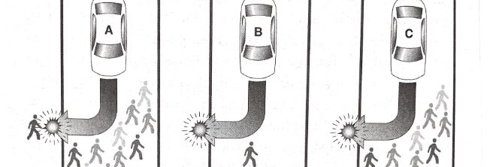
AI in Self-driving Car
The three self-driving car traffic situations that result in imminent, unavoidable harm. The car must decide whether to
Kill several pedestrians or one passerby;
Kill one pedestrian or its own passenger;
Kill several pedestrians or its own passenger.

Slide 8
Process for AI to choose in An Ethical Manner
Recognize that there is an event that requires a reaction
Determine that the event has ethical implications
Take personal responsibility for generating an ethical solution to this problem.
Identify relevant principles, rights and justice issues.
Decide how these abstract ethical rules apply to the problem to reach a concrete decision/solution.
Act.

